Slide 1
Session 6 – Sankhya & Vaisheshika
(Psychology : Three types of Natures)
1) The three types of Natures.
2) Impact on consciousness &
role of free will v/s conditionings.

Slide 2
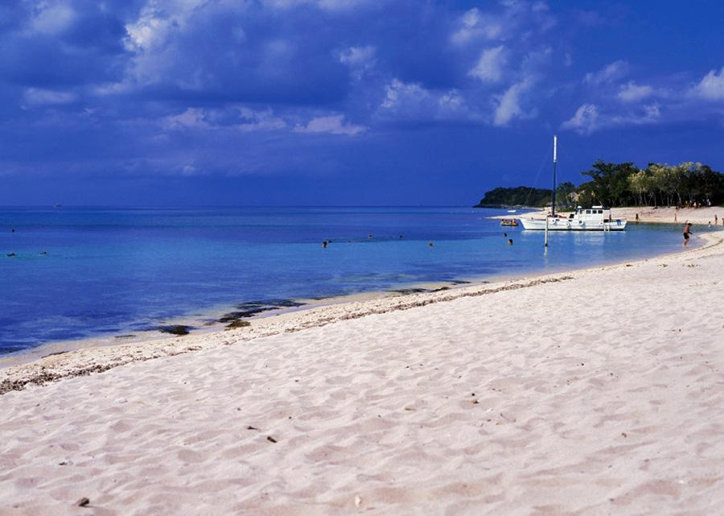
The Dual model
Inferior Material Body
Superior Spiritual Body
3
Bodi
es
2. Subtle or (Body of Desires)
(Functions)
1. Mind
2. Intelligence
3. False Ego
Gross or (Precipitate Body)
(Elements)
1. Earth
2. Water
3. Fire
4. Air
5. Ether
3.Spiritual Body (Soul)
(Characteristics)
1. SAT (Eternal)
2. CIT (Knowledge)
3. ANANDA (Bliss)
Notes:
Example of Computer : Hardware, Software and User. Consciousness of the soul : 4 states : Jagrti, sushupti, svapna and samadhi.
Role of Attention done by the mind in coordination of internal cognition with the senses.

Slide 3
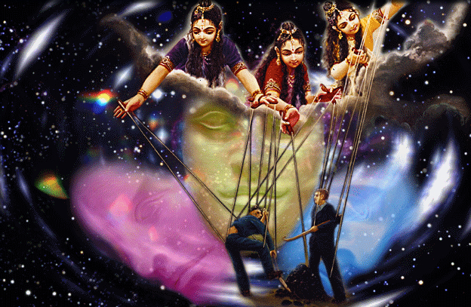

Slide 4
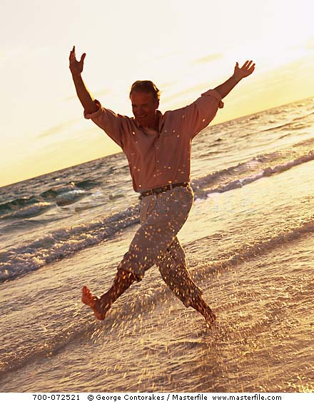
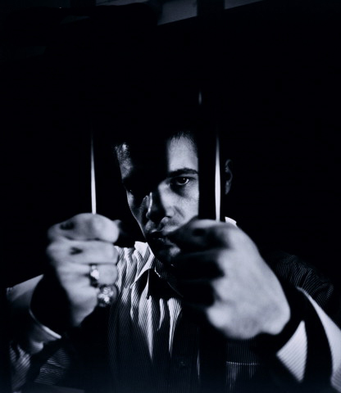
What makes one a slave ? How can I become a free bird?

Slide 5
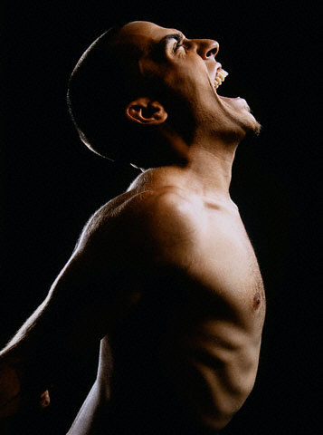

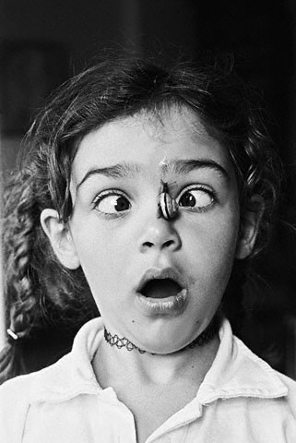
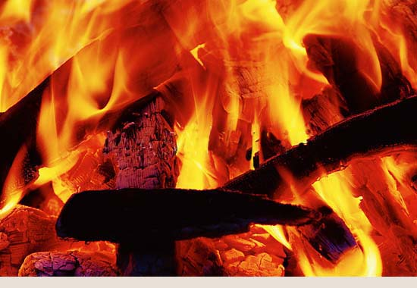
Passion
Goodness
Ignorance
Running with agitated mind
Calm analysis before action
Panic
Confusion
fear
Notes:
Story

Slide 6
Characteristics of one in Mode of Goodness (Thoughtful person)
When a person is situated in Sattva:
Penchant for virtue, integrity, self-discipline, abstinence, cleanliness, peacefulness and profound knowledge.
Likes to reside in quiet locale – mountains, forest, countryside.
Loves philosophy, poetry, music and science that focusses on ultimate issues of life.
Elevated state of self-contentment and knowingness.

Slide 7
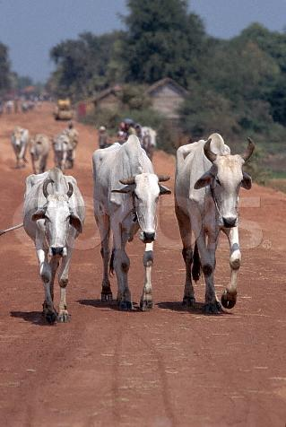
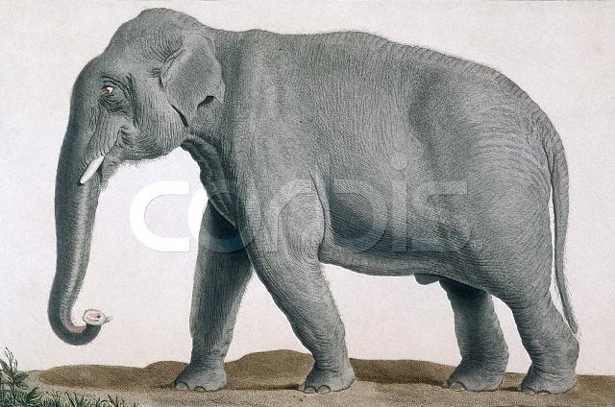
Animals in Goodness

Slide 8

Mode of Goodness
Reading of books of philosophy, poetry, science
Honest
Clean
Humble
selfless
thoughtful
No gambling
helpful
No intoxication
pious
No liquor
Take religion as a serious duty
No extramarital relations

Slide 9
Leaders or Managers functioning in goodness
When a leader is situated in Goodness
Feels low tension and high energy
Feels remarkably serene and under control
Replaces tense energy with an alert, more optimistic presence of mind,
peaceful
Pleasurable body feelings, deep sense of physical stamina and well being.
Mental and physical reserves are high
Best combination of healthy vitality and increased creative intelligence
A kind of flow state of relaxed alertness or mental and emotional overdrive
An extra gear that allows you to do just as much or even more but with
less struggle, less wear and tear

Slide 10
Characteristics of one in Mode of Passion (Aggressive person)
When a person is situated in Rajas:
Feverish endeavour to get ahead (Rat race)
Pride in abilities & possessions.
Hearty diet of physical indulgence (Work hard Party harder philosophy)
Lifestyle of work, buy, consume and die.
Money and sex too being key motivating factors.

Slide 11
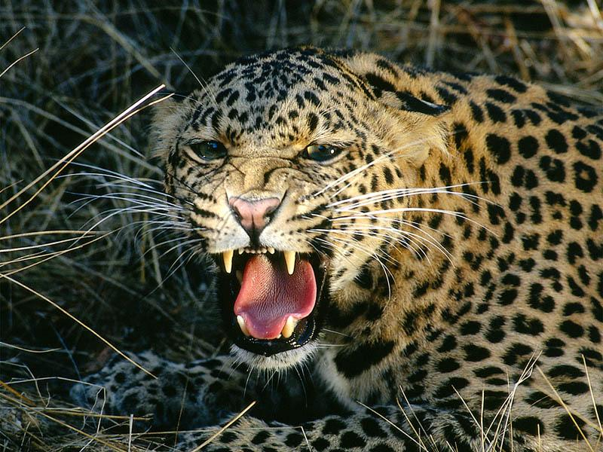
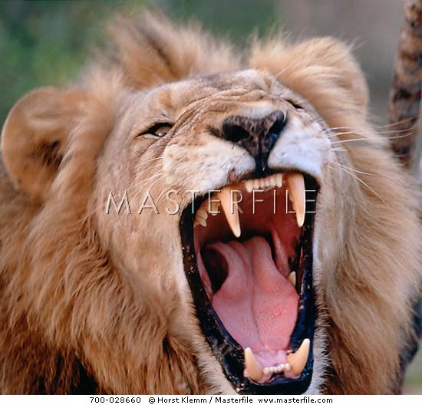
Animals in Passion

Slide 12
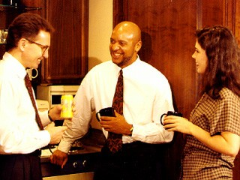
Mode of Passion
Mad after seeing and showing glamour
Gives charity for fame
Hard labor for honor
Wound mind and disturbed sleep
Selfish & Egoistic
Religion :
a social affair
Money is honey
Disregard scriptures
Attraction between man and woman
Hankering for family prestige

Slide 13
Leaders or Managers functioning in passion
When a leader is situated in Passion
He has a stress-driven mood characterised by almost pleasant sense
of excitement and power
His physical energy feels high, even though he may face high levels
of stress or strain from long hours of hectic schedule
In a tense energy state, he tends to impatiently push himself towards
one objective after another rarely pausing to rest or reflect.
His efforts are infused with a moderate to severe level of physical tension,
which after a while may be imperceptible to him.
Without realising it, by allowing this situation to persist, he blunts his ability
to pay deep, genuine attention to his own needs, other people’s needs,
project needs and
can suddenly wake up to find himself at the edge of burnout and exhaustion

Slide 14
Characteristics of one in Mode of Ignorance (Insane person)
When a person is situated in Tamas:
Perverse and lethal
Wallow in sloth, excessive sleep, dejection & intoxication.
Finale is deadly anger, pointless violence & mental derangement.
Abhors work, lethargic without any goal.
Passes time in a cloudland of drugs, alcohol, dreaminess and the blues.

Slide 15
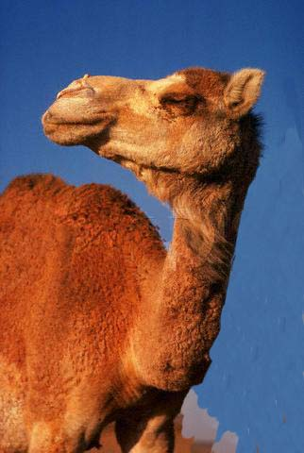
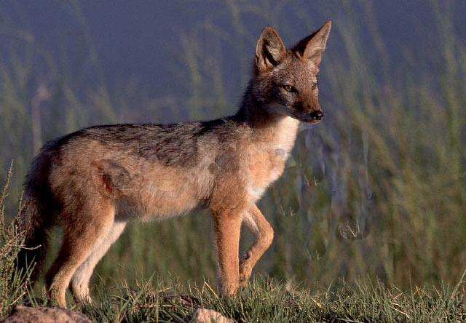
Animals in Ignorance

Slide 16
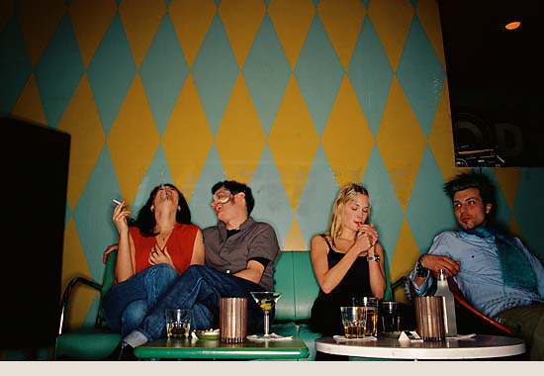
Mode of Ignorance
foolish
Dizzy and lazy
No interest in spiritual life
Unclean
Disturbing to others
postponing
mad
intoxicants
Nothing to do with God
Drugs, wine
Sleeping too much

Slide 17
Leaders or Managers functioning in three modes : Ignorance
When a leader is situated in Ignorance
He feels tired all over.
He collapses in his chair/sofa at night.
His fatigue is mixed with nervousness, tension or anxiety.
He is not pleasant and often there is a sense of low
esteem and of life being a burden.
Depression may be triggered or worsened.
He feels undesirable moods, negative thoughts and
dysfunctional behaviour and takes drug or alcohol to
alter mood.

Slide 18
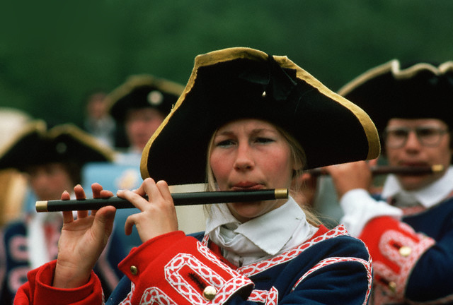
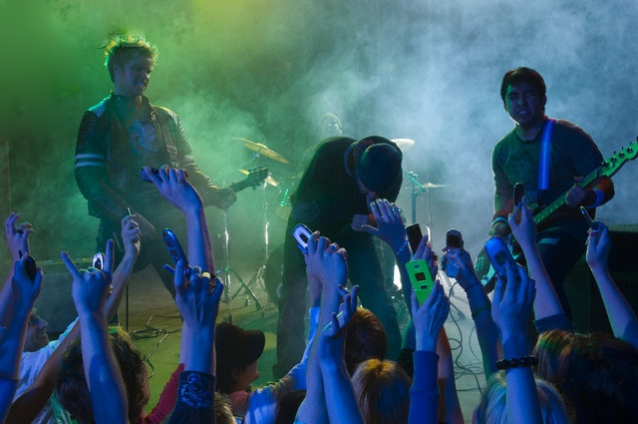

3 Modes (chains) of Material Nature - Music
Goodness
Passion
C
Ignorance

Slide 19
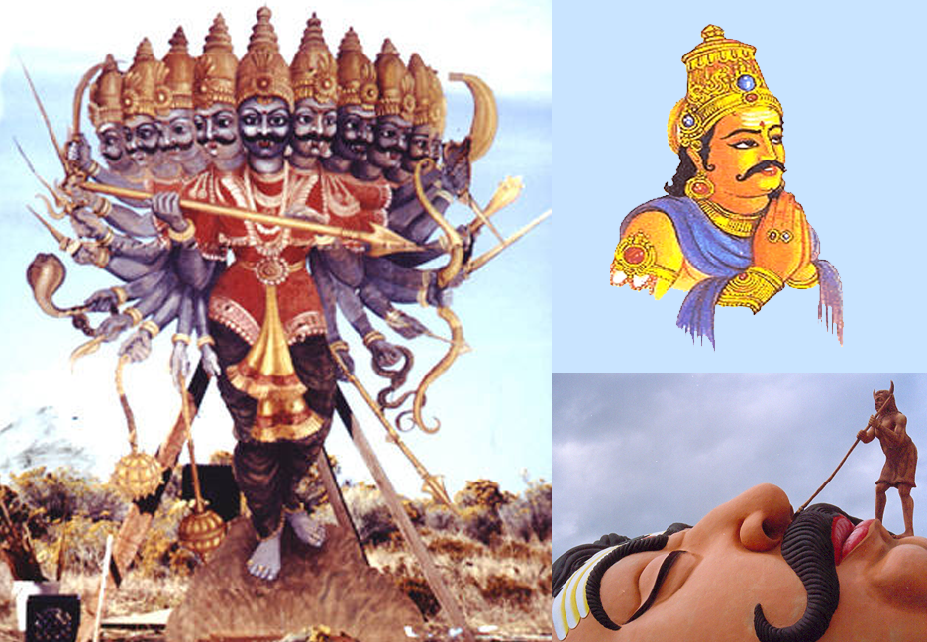
3 Modes (chains) of Material Nature
Goodness
Sattva Guna - Vibhishana
Ignorance
Tamo Guna - Kumbhakarna
C
Passion
Rajo Guna - Ravana

Slide 20
GUNA | SATTVA | RAJAS | TAMAS
Outlook | Detachment | Desire | Ignorance
Motive | Knowledge | Enjoyment | No goal
Mentality | Peaceful | Active | Irrational
Future | Upper worlds | Earth | Lower worlds
Food | Vegetable | Animal vegetable | Animal
Health | Long term | Short term | Destructive
Worship | Desireless | Motivated | Concocted
Knowledge | Atma | My body + others | My body
Action | Selfless | Motivated | Violent
Values | Values based on truth, scripture | Self-centered values | False values

Slide 21
Application of (3 modes) Psychology
1. Free will v/s conditionings and choice
2. The four Varna concept of India

Slide 22
Thank You

